Slide 1

Conformal LSTM Classifier to detect anomalies using
Individual project presentation
MSc in Data Analytics
April 7th, 2025
Bharath Shakthivel - 20057027

Slide 2
INTRODUCTION
01
02
03
WHY LSTM?
KEY APPROACH
GOAL
Predicting the anomalies for time series data based on conformal prediction.
Develop a LSTM classifier model using Julia.
- Remembering Long-Term Patterns
- Sequential Data Handling
- Useful for Multivariate Time Series
- Flexible for Many Tasks -Forecasting, Anomaly detection, Sequence generation

Slide 3
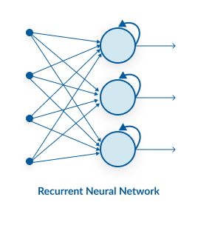
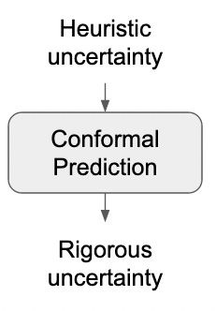
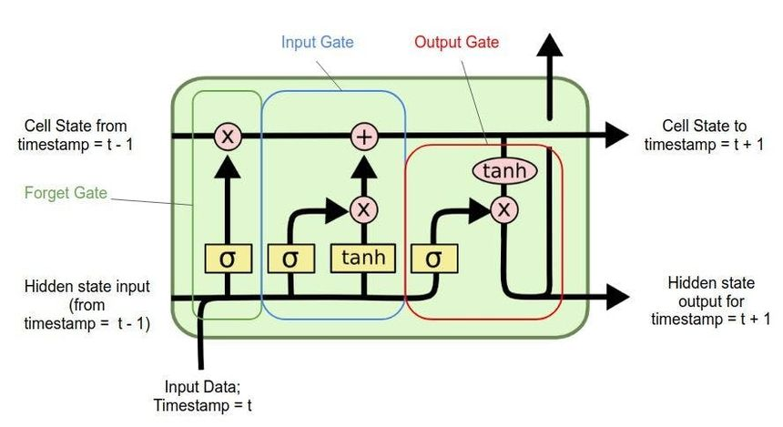
LSTM & Conformal Prediction
LSTM (Long Short-Term Memory): A type of Recurrent Neural Network (RNN) designed to handle sequential data like time series. Uses memory cells and gating mechanisms (input, forget, output) to capture long-term dependencies. Ideal for modeling temporal patterns, trends, and cycles in time series data. Commonly used for forecasting, anomaly detection, and sequence classification.
Conformal Prediction: A statistical technique that provides reliable prediction intervals with a chosen confidence level (e.g., 95%).Works on top of any machine learning model, offering valid uncertainty estimates. Ensures predictions are statistically sound, even on unseen data. Useful for anomaly detection, risk estimation, and trustworthy AI systems.

Slide 4


METHODOLOGY & METRICS
Trained an LSTM model on Traffic_Travel-time – 387 time series data to predict future values and detect anomalies using conformal prediction approach.
Anomaly Detection: Anomaly scores were computed on Travel_time – 451
using the trained LSTM. Scores were normalized using Min-Max Scaling and compared
with the benchmark results of the NAB
Evaluation:
Low regression errors (RMSE: 0.082, MAE: 0.033, MSE: 0.006) indicate good model performance.
Anomaly score accuracy estimated between 91–96%, depending on tolerance levels.
Note: NAB scorer could not be loaded, so results were compared directly to NAB
benchmark outcomes.

Slide 5
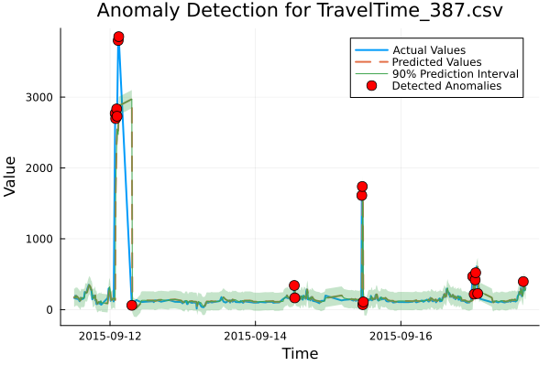
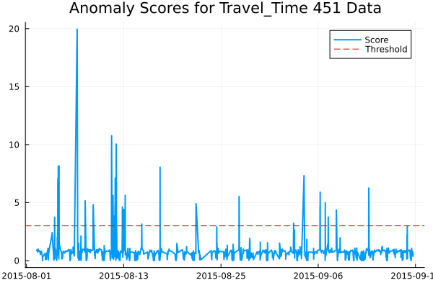
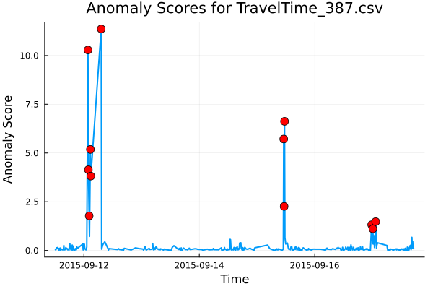
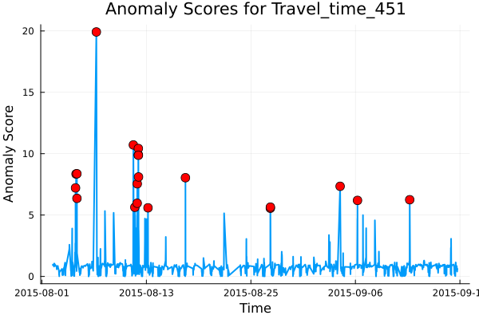
VISUALIZATIONS

Slide 6


CHALLENGES & FUTURE IMPROVEMENTS
-Data Scaling Sensitivity – Required careful normalization for stable predictions.
-Threshold Tuning – Selecting accurate anomaly thresholds was tricky.
-High Computation – LSTM and conformal scoring were resource-intensive.
-Poor Generalization – Model trained on one dataset didn’t always transfer well.
-Evaluation Gaps – NAB scorer failed, limiting standardized validation.
-Low Interpretability – Hard to explain anomalies due to model complexity.
Hyperparameter Tuning - Optimize LSTM layers, learning rate, and batch
size for better accuracy.
Dynamic Model Design - Develop a robust framework that adapts to different
time series characteristics.
Automated Thresholding - Implement dynamic threshold selection for conformal
scores using statistical methods.
Model Generalization - Train with diverse datasets to improve adaptability across
domains.
Scalable Deployment - Optimize model performance for real-time or large-scale time series applications.

Slide 7
REFRENCES
Evaluating Real-Time Anomaly Detection Algorithms -- The Numenta Anomaly Benchmark
- The Numenta Anomaly Benchmark (NAB) is an open-source framework for evaluating real-time anomaly detection algorithms on diverse, real-world streaming time-series data. (https://ieeexplore.ieee.org/document/7424283)
LSTM
- Hochreiter, S., & Schmidhuber, J. (1997). Long short-term memory. Neural Computation, 9(8), 1735–1780. (https://doi.org/10.1162/neco.1997.9.8.1735)
Conformal Prediction
- Barbareschi, M. A., et al. (2021). Conformal prediction for time series data. Statistical Analysis and Data Mining: The ASA Data Science Journal. (https://doi.org/10.1002/sam.11356)

Slide 8

THANK YOU
Questions?

